Slide 1
Unit 10: Building Websites using Joomla
By: Asst.Prof. Ms. Leena Divkar
S.V.’s Sridora Caculo College of Commerce & Management Studies, Mapusa Goa

Slide 2
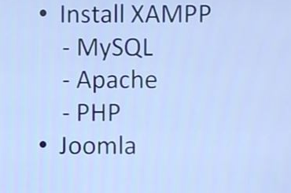
Installing Joomla
Joomla installation components:

Slide 3
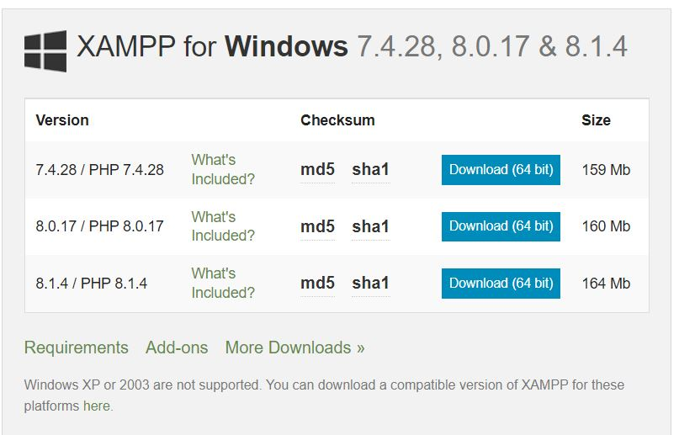
Step 1: Installation of XAMPP
Go to: https://www.apachefriends.org/download.html
click on download

Slide 4
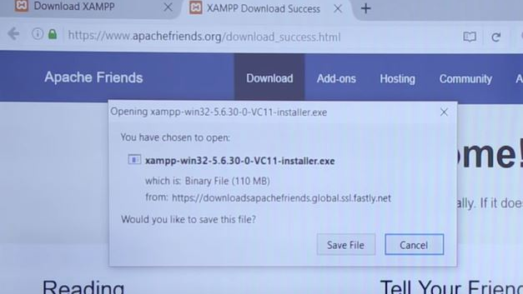
Step 1: Installation of XAMPP
Follow the steps and install XAMPP
Go to browser & type localhost/phpMyAdmin
Create a database

Slide 5
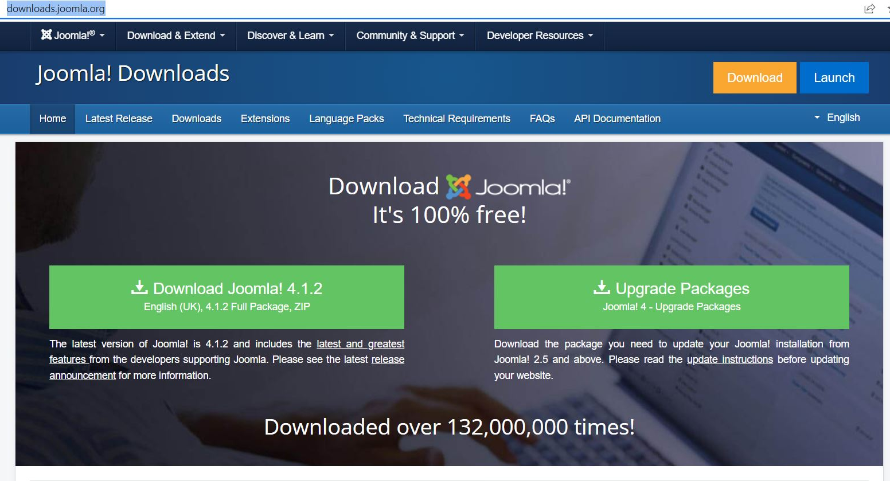
Step 2: Installation of Joomla
Go to: https://downloads.joomla.org/
Click on

Slide 6
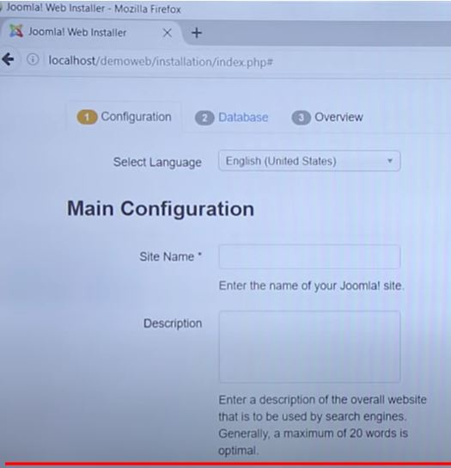
Step 2: Installation of Joomla
Copy Joomla folder in xampp→htdocs→new_folder
Extract Joomla File
Go to the browser & type: localhost/new_folder
Add all the details in the configuration section like: select language, site name, add description, site offline→NO

Slide 7
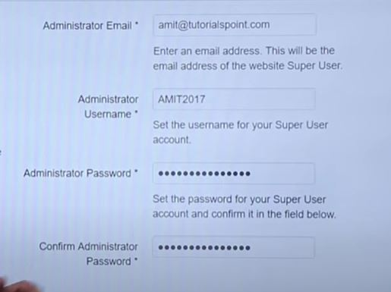
Step 2: Installation of Joomla
Add administrator email, username, password→Click on Next

Slide 8
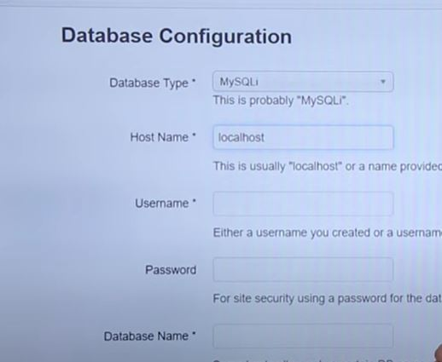
Step 2: Installation of Joomla
In database configuration, select:
database type→MYSQLi
Hostname→localhost
Username →root
Password→keep blank
Backup→next

Slide 9
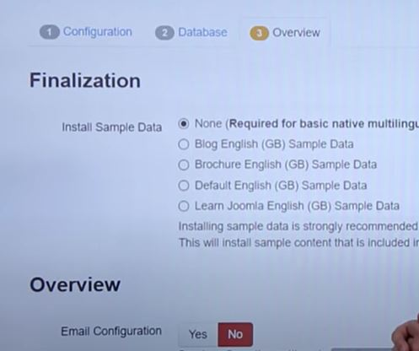
Step 2: Installation of Joomla
In the overview section: Sample data→select as Default English and click on Install
After that remove installation folder

Slide 10
Joomla Website First Page
Go to browser & type: localhost/new_folder

Slide 11
References:
https://youtu.be/08s1vfU-lmc

